Slide 1

Student Management System
GDIPSA 49 Team 2
ADHIYAMAN SISUBALAN
AYE PWINT PHYU
ONG JUN HAO, EDMUND
RUAN XINPING
SAO SAI WOON LENG
WEI YIHENG

Slide 2
WORK DISTRIBUTION
Database design is discussed and agreed upon on a group level
Basic wireframes design were drafted by hand
Split into 2 groups: Back-end and Front-end
Ong Jun Hao, Edmund, Aye Pwint Phyu and Sao Sai Woon Leng implement the back-end part
Adhiyaman Sisubalan, Ruan Xinping and Wei Yiheng develop the front-end part
Back-end workload: Models/Controllers
Front-end workload: Views

Slide 3
Software Architecture Layer
Presentation Layer
HTML Pages
(Display)
Business Layer
Controllers
Methods
Business
Logic
Persistence Layer
DAO
Repository/Service
Data Layer
MySQL
Database

Slide 4
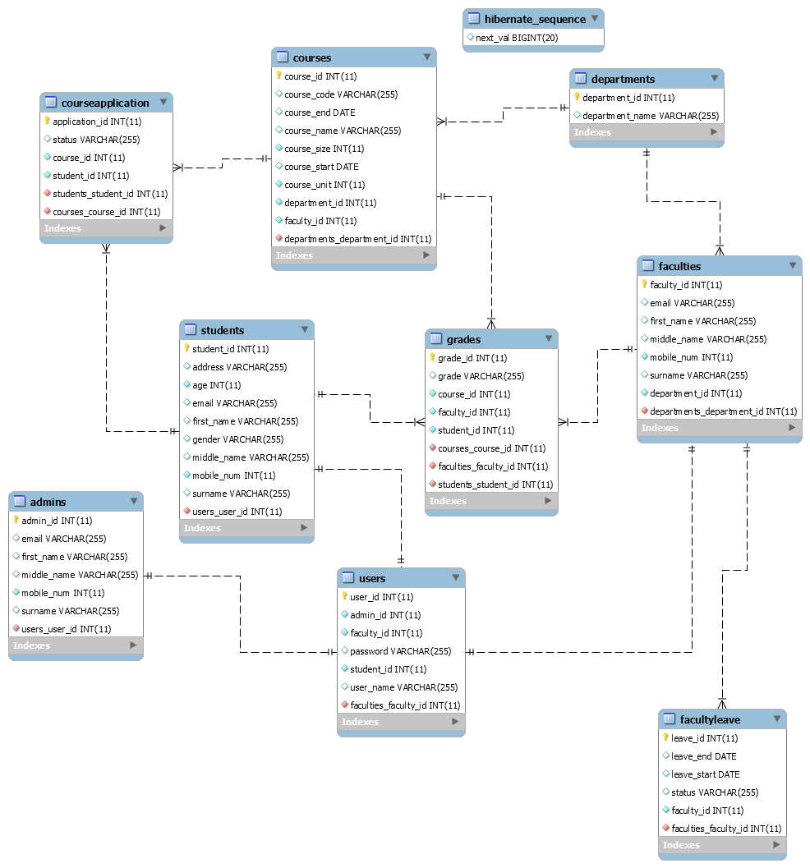
ERD Diagram

Slide 5
Technologies Used
GitHub
Spring Boot MVC/Spring JPA/Spring Hibernate
Pagination
CSV writer
Bootstrap for design
Thymeleaf for html pages
Email Interaction

Slide 6
Lessons Learnt
Wireframe design to be done as early as possible
Entity Relationship/Object Mapping must be done properly
The power of annotations in JAVA programming
Github knowledge
Communication
Communication

